Slide 1

SmartCrop – AI & IoT-Based Crop Suitability and Monitoring System
30% Presentation Template
By
By Zulkifl Ahmad SP23-BCS-047 Aleeza Javed SP23-BCS-141 Muneeba Kalsoom SP23-BCS-147
Supervisor : Sir Yasar Khan
Department of Computer Science
COMSATS University Islamabad, Abbottabad Campus

Slide 2
Agenda of the Presentation
Brief Introduction
Scope
Functional Requirements
Non-Functional Requirements
User Goals
Use Cases
Diagrams
Project Schedule (Gantt Chart)
1st Iteration (30%)
2nd Iteration (60%)
Conclusion

Slide 3
Brief Introduction
SmartCrop is an AI and IoT-based smart farming system designed to improve agricultural productivity through intelligent monitoring and decision support.
The system collects real-time soil and environmental data using ESP32 and IoT sensors, stores the data in Firebase, and applies machine learning models to provide crop recommendations, fertilizer suggestions, yield prediction, weather forecasting, and remote irrigation control through a Flutter mobile application.

Slide 4
Scope
What the System Will Do
Monitor soil and environmental conditions in real time
Store sensor data in Firebase Cloud
Recommend suitable crops using Machine Learning
Predict crop yield
Recommend fertilizers
Display weather forecasts
Enable remote irrigation control
Display historical sensor data
Provide secure user authentication

Slide 5
Scope
What the System Will NOT Do
Pest detection
Plant disease detection
Automatic AI-based irrigation decisions
Multi-language support
Web-based management dashboard
Support for platforms other than Android

Slide 6
Functional Requirements
User Authentication Secure registration, login, password recovery, profile management, and logout using Firebase Authentication.
Sensor Monitoring Displays real-time and historical values of soil moisture, temperature, humidity, pH, NPK, and EC collected from ESP32.
Crop Recommendation Uses machine learning to recommend the most suitable crop and provides fertilizer suggestions and yield prediction.
Weather Forecast Retrieves weather information through the Weather API to assist irrigation planning.
Irrigation Control Allows farmers to remotely switch the irrigation pump ON/OFF and synchronizes irrigation status in real time. User Profile

Slide 7
Functional Requirements
User Profile Allows users to update profile information and securely manage their accounts.

Slide 8
Non-Functional Requirements
Usability
Easy-to-use mobile application
English language support
Crop recommendation within a few minutes
Responsive Android application
Simple navigation
Clear validation messages
Performance
Dashboard loads within 5 seconds
AI recommendations within 10 seconds
Irrigation response within 2 seconds
Supports multiple authenticated users

Slide 9
Security
Secure Firebase Authentication
User data privacy
Reliability
Continuous cloud synchronization
Data recovery after network interruption

Slide 10
User Goals
Monitor field conditions remotely
Receive AI-based crop recommendations
Reduce water wastage
Plan irrigation using weather forecasts
Receive instant alerts
Improve crop productivity
Make informed farming decisions

Slide 11
Use Cases
Register
Login
Forgot Password
View Dashboard
Monitor Live Sensor Data
Get Crop Recommendation
View Yield Prediction
View Fertilizer Recommendation
View Historical Data
View Weather Forecast
Control Irrigation
Manage Profile
Logout

Slide 12
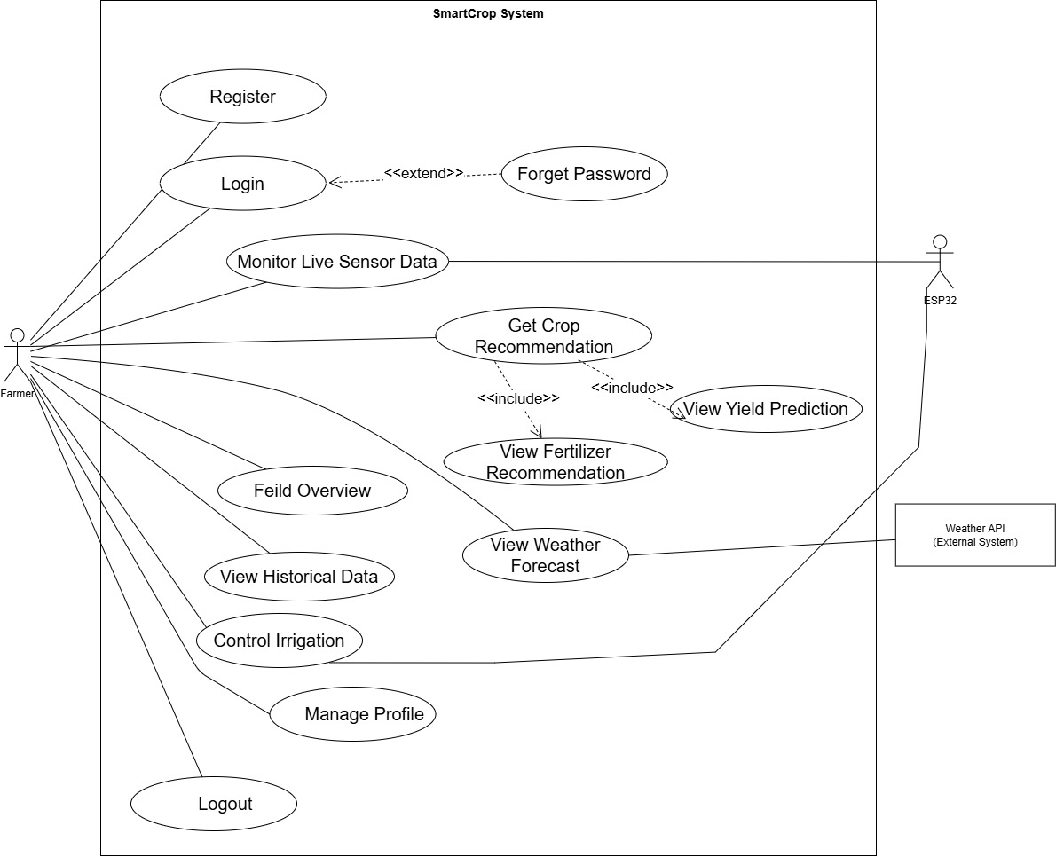
Use Case Diagram

Slide 13
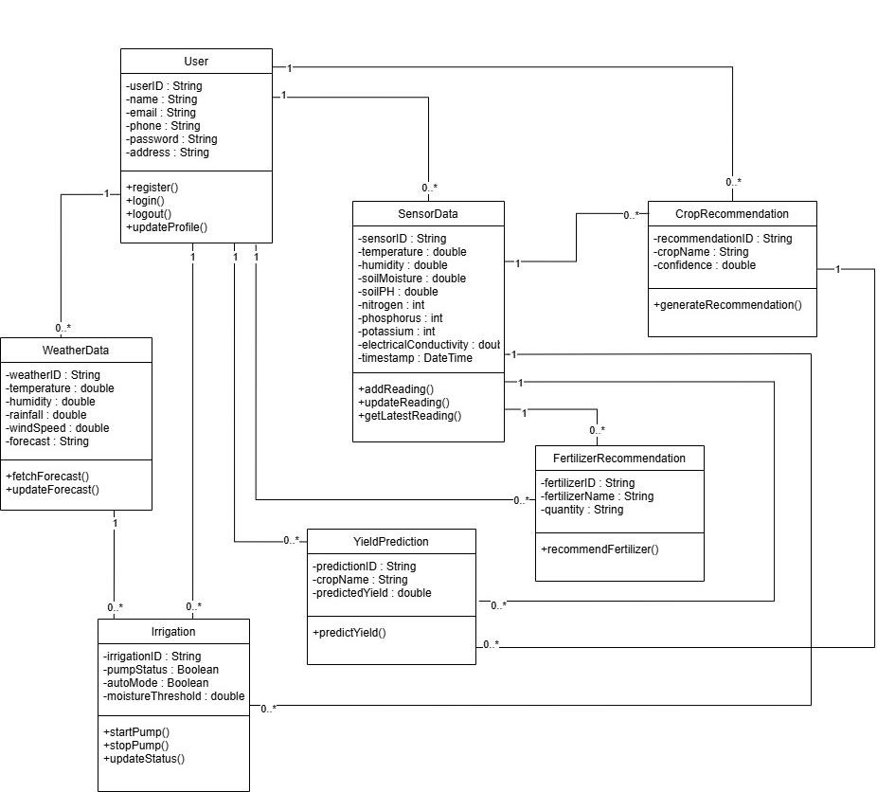
Class Diagram

Slide 14
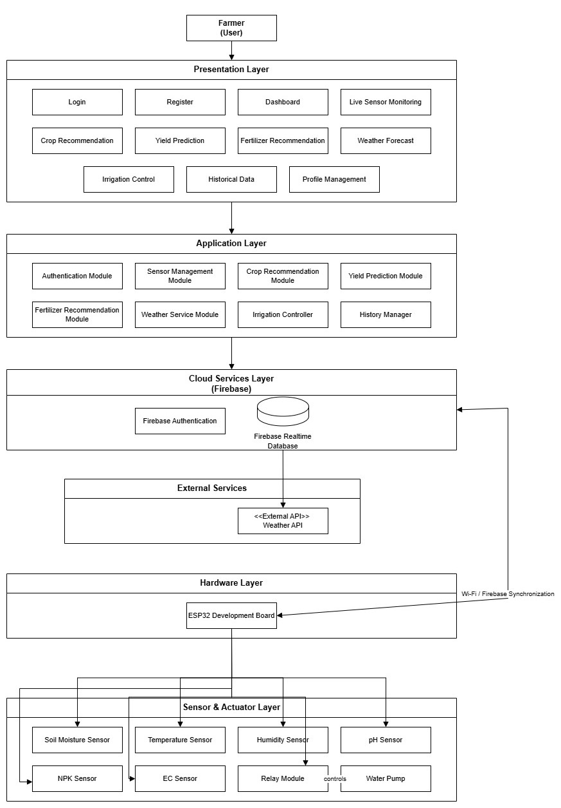
Layered Architecture Diagram

Slide 15
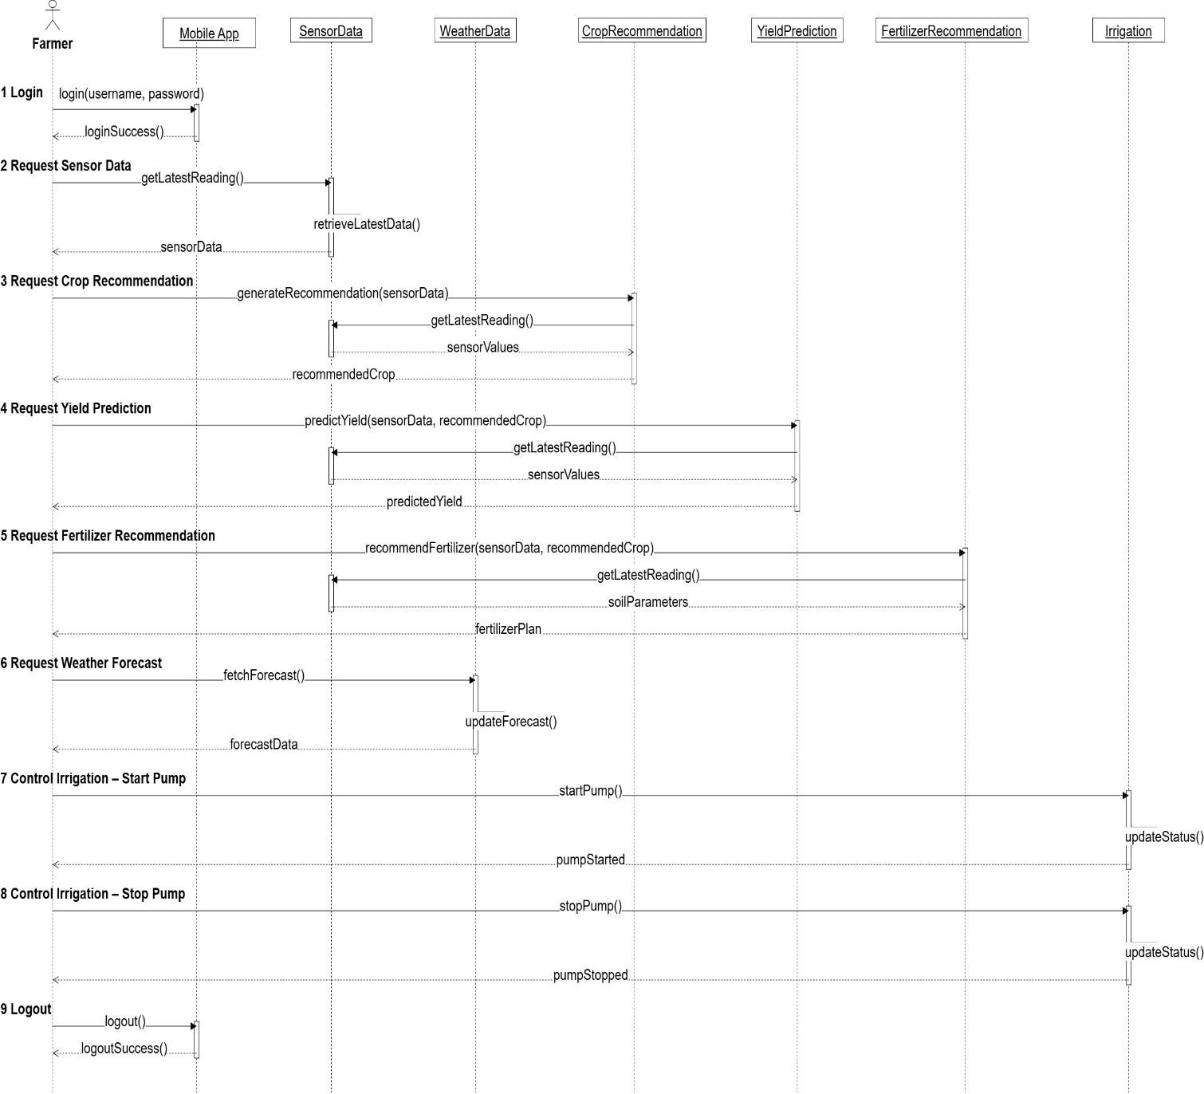
Sequence Diagram

Slide 16
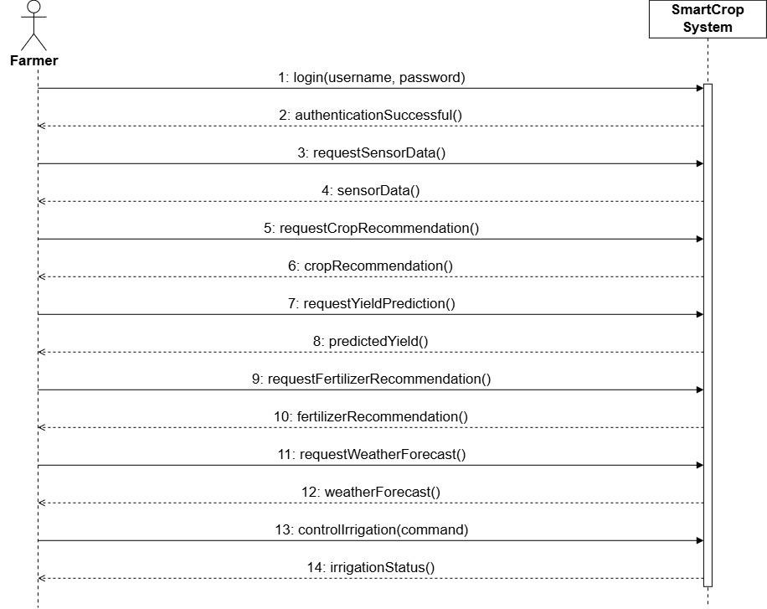
System Sequence Diagram

Slide 17
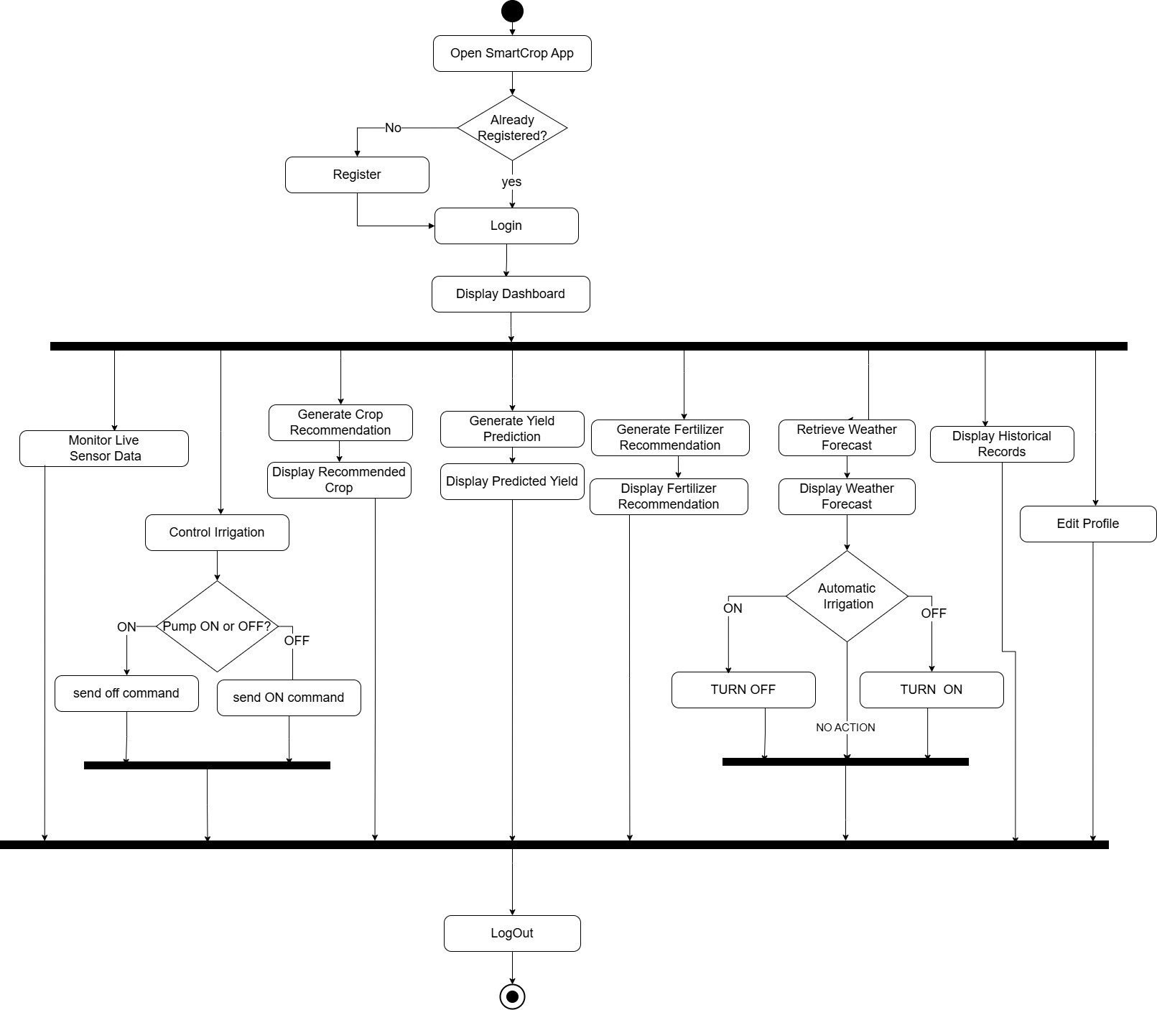
Activity/State Machine Diagram

Slide 18
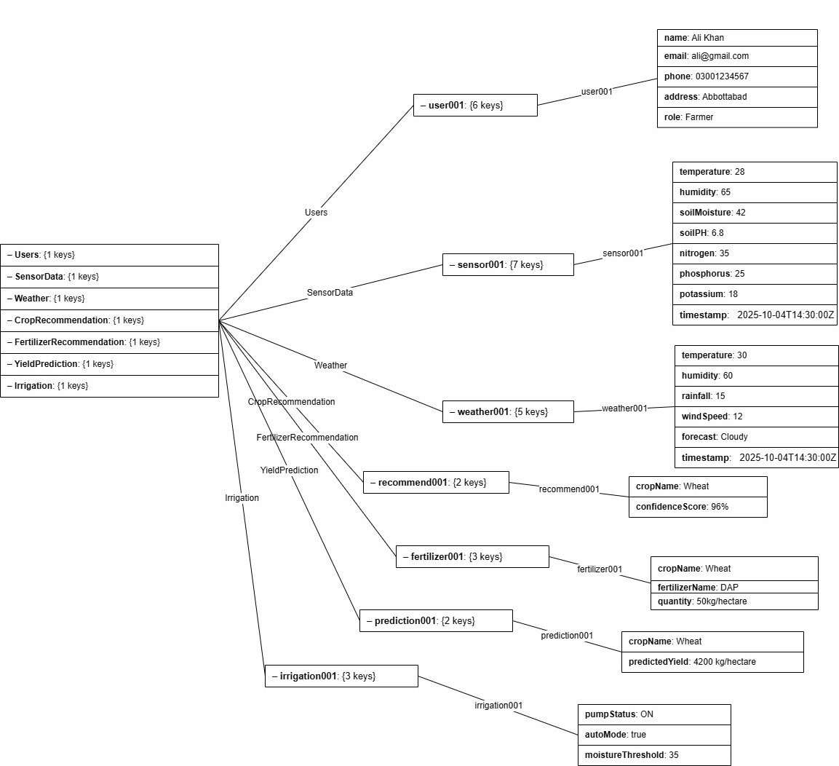
Firebase Json Tree

Slide 19
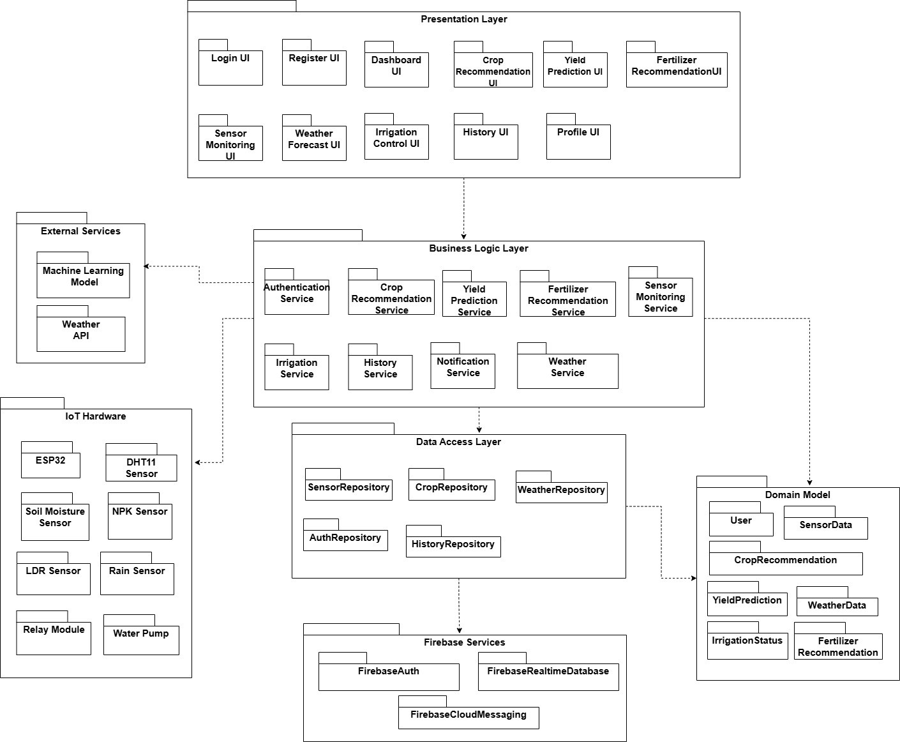
Package Diagram

Slide 20
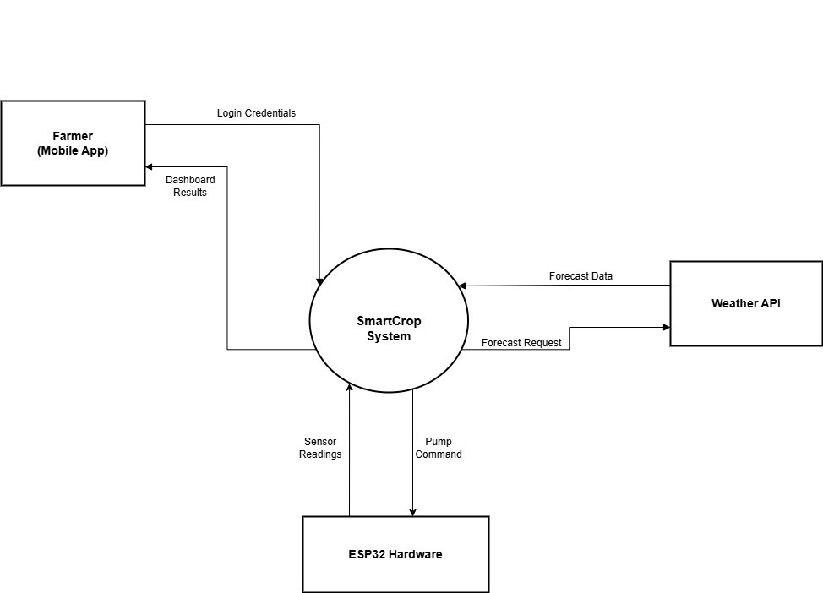
DFD Level 0

Slide 21
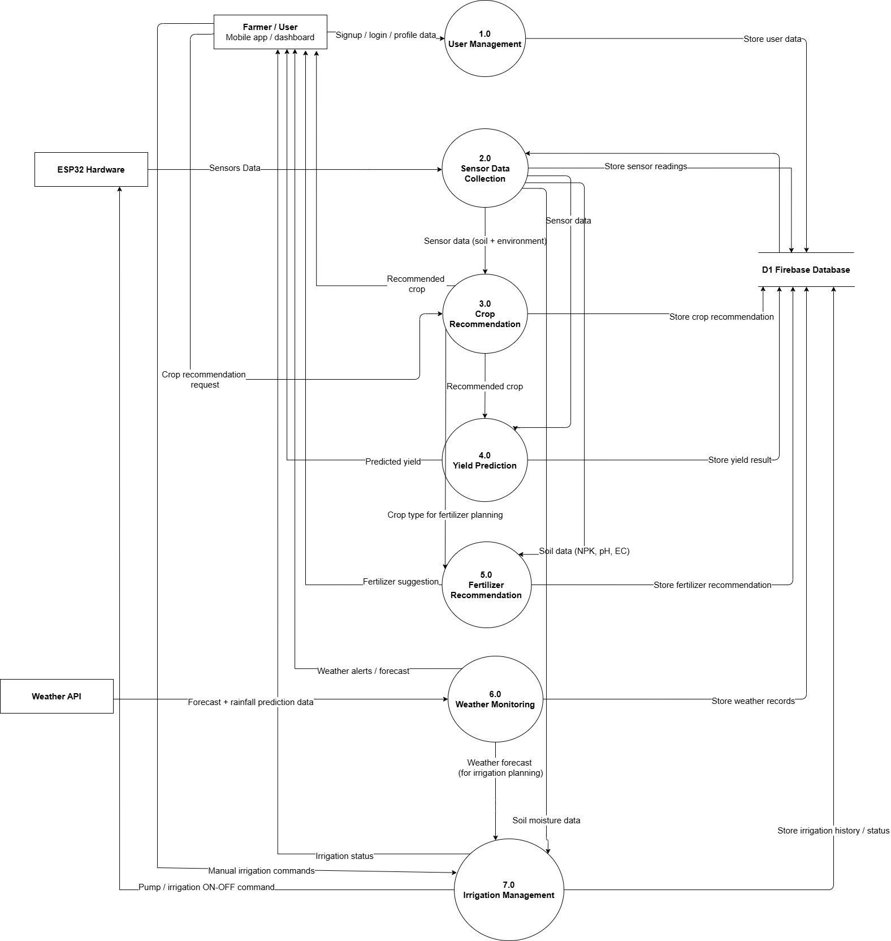
DFD (Level 1)

Slide 22
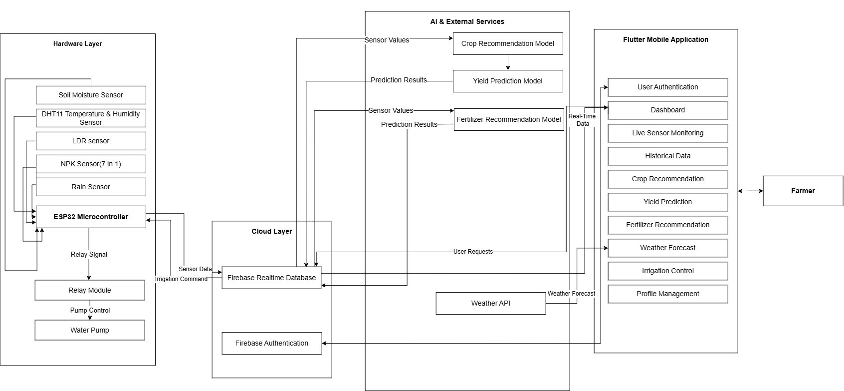
System Block Diagram

Slide 23
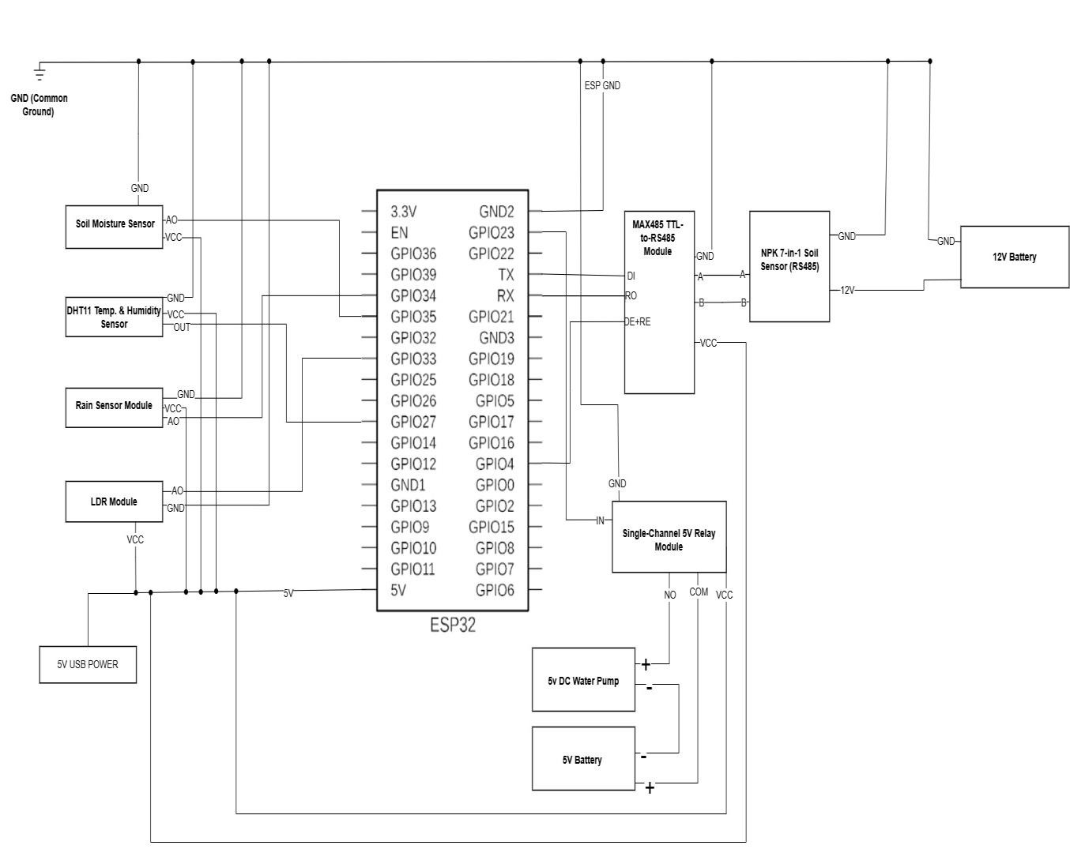
Hardware Schematic Diagram

Slide 24
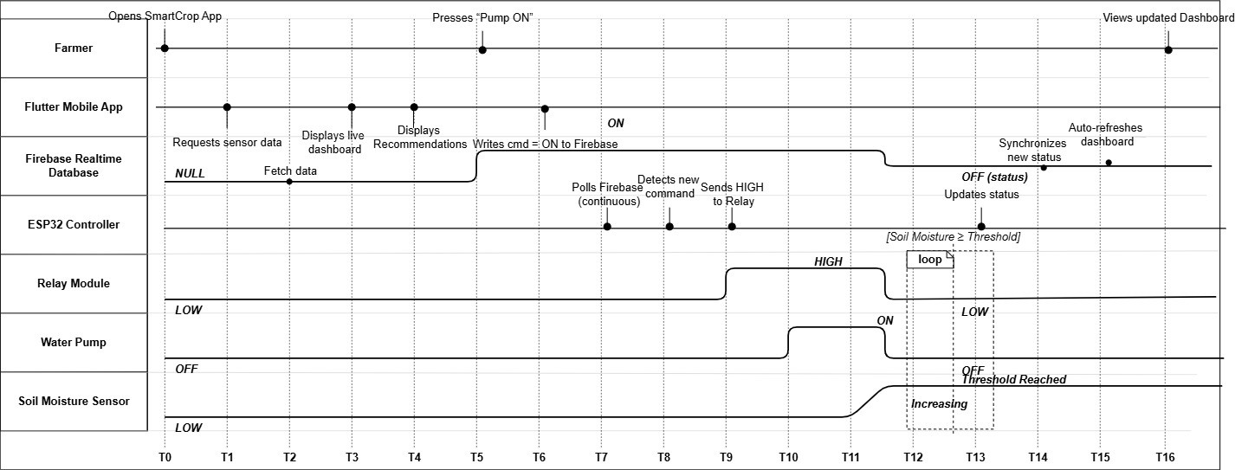
Timing Diagram

Slide 25
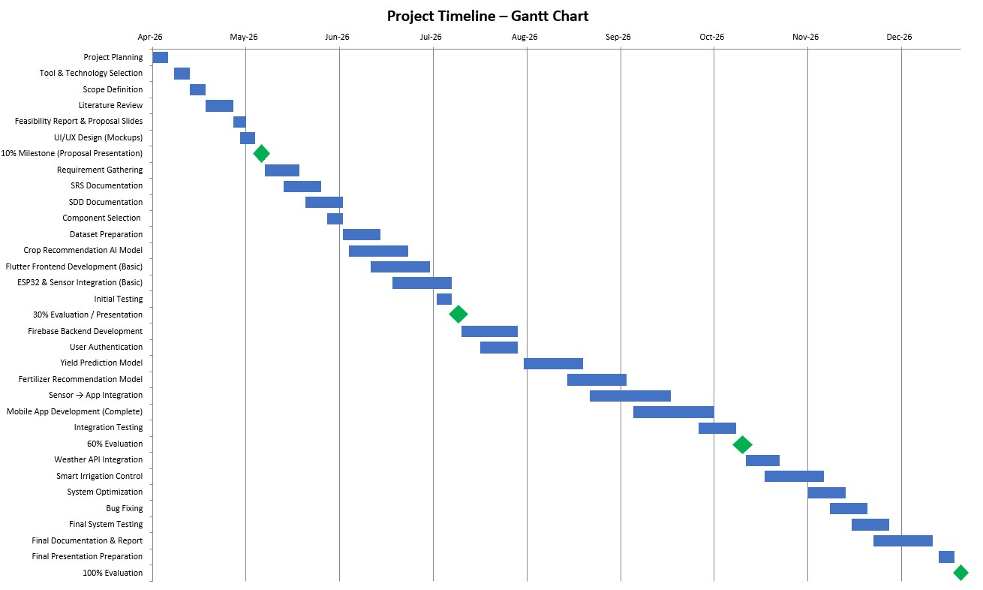
Schedule

Slide 26
Details of 1st Iteration (30%)
Requirement Gathering
SRS Documentation
SDD Documentation
Component Selection
Dataset Preparation
Crop Recommendation AI Model
Flutter Frontend Development (Basic)
ESP32 & Sensor Integration (Basic)

Slide 27
Details of 2nd Iteration (60%)
Firebase Backend Development
User Authentication
Yield Prediction
Fertilizer Recommendation Model
Sensor-to-Mobile App Integration
Complete Flutter Mobile Application
Integration Testing

Slide 28
Conclusion
SmartCrop integrates AI, IoT, cloud computing, and mobile technology to support smart farming.
The system enables real-time monitoring, intelligent recommendations, and remote irrigation management.
The project follows the planned development schedule and will continue with implementation, integration, and testing in the upcoming iterations.

